Slide 1
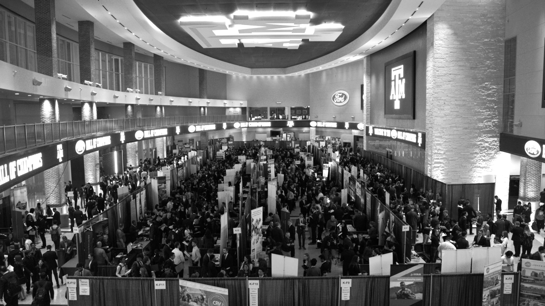

LANL Team Update
10/09/2024
Izzy Baumler, Dalton Boeckmann, Morgan Gullo, Jade Waldron

Slide 2
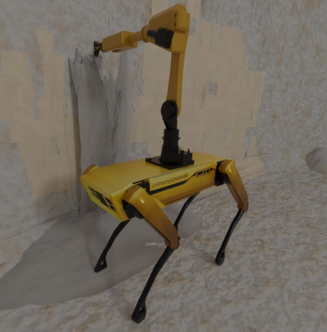
Mission Statement
To design and prototype a semi-autonomous robotic arm that is attached to the Boston Dynamics Spot quadruped robot that can cover a 2 foot radius area.

Slide 3
Weekly Updates
Continued Static Analysis
Inverse Kinematics Calculations Finished and Validated
Solution Workspace Calculated for 2 Different Robotic Arms
Electronics Research
Site Visits

Slide 4
Static Analysis
Goal: Perform static analysis to determine maximum weight on end of arm
Results:
Used Specs and GrabCAD of Spot robot to determine distances
Drew diagram of forces
Created Code to calculate forces incase parameters change
Obtained values of F1= 184, F2= -168, Mt = -29.51
This is wrong because of the negative signs

Slide 5
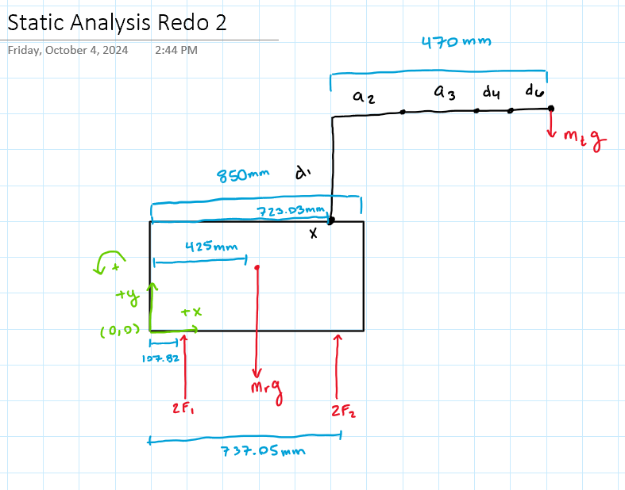
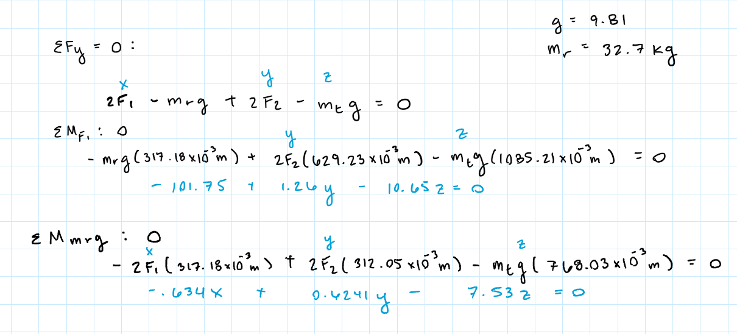
Static Analysis

Slide 6
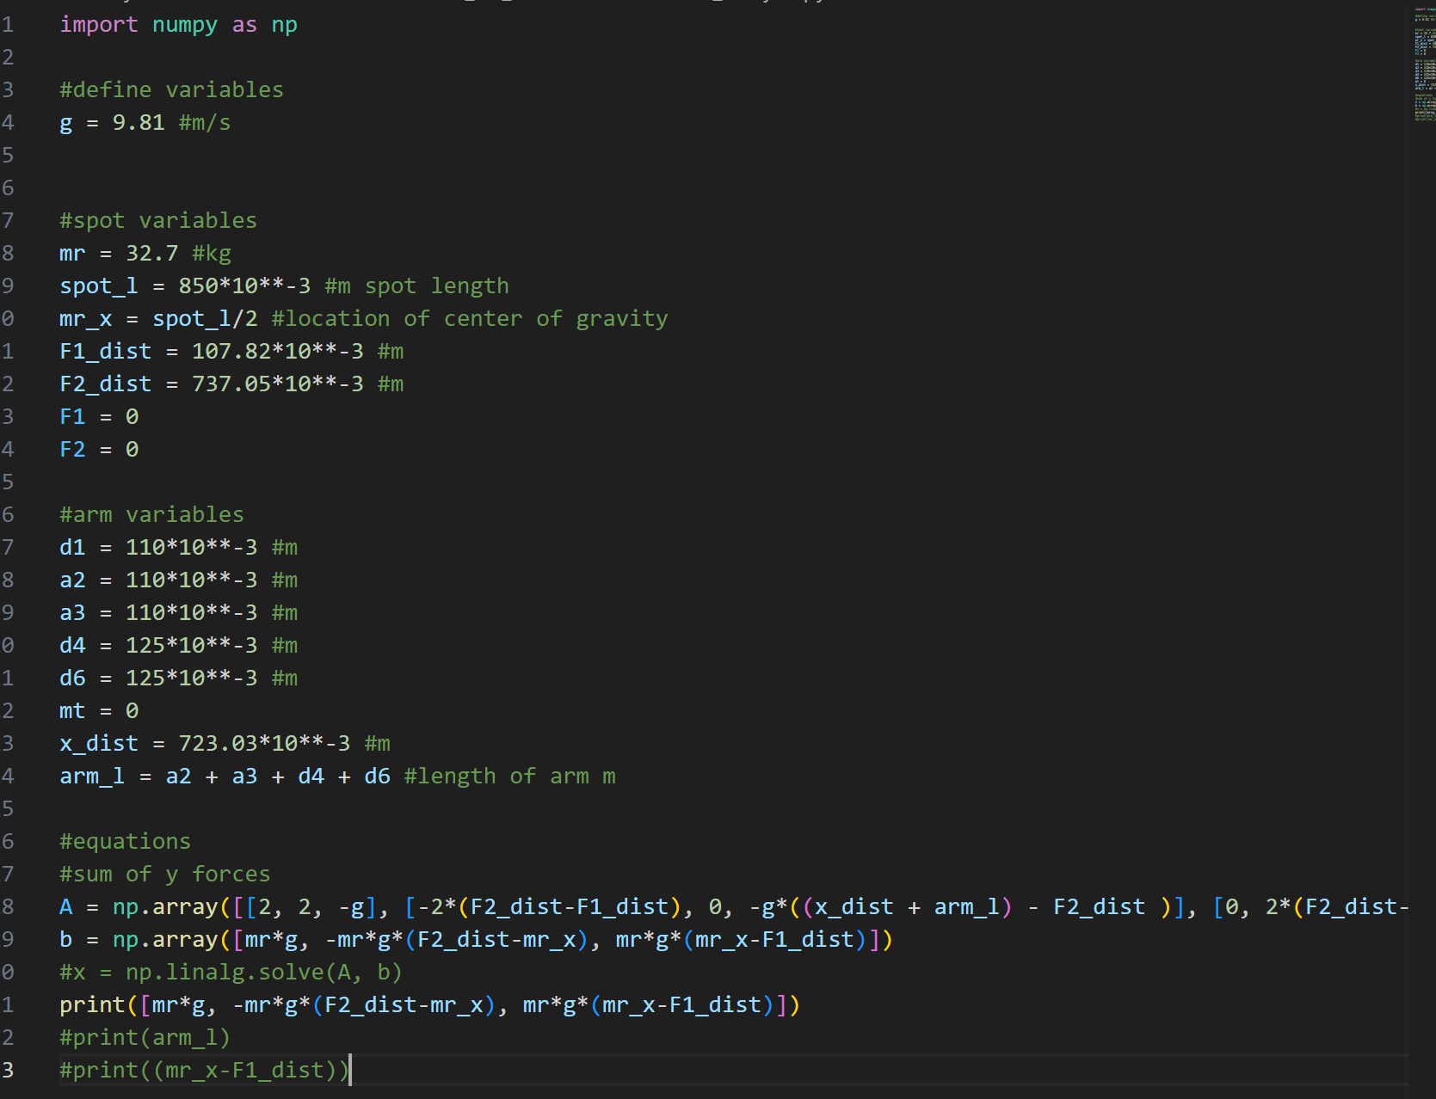
Static Analysis Code

Slide 7
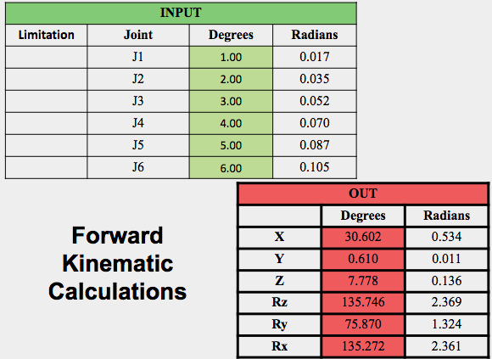
Inverse Kinematic Analysis
Input
 | Degrees | Radians
X | 30.602 | 0.534
Y | 0.610 | 0.011
Z | 7.778 | 0.136
Rz | 135.746 | 0.000
Ry | 75.870 | 0.000
Rx | 135.272 | 0.000
Inverse Kinematic Calculations
Inverse Kinematics Calculations:
Completed and verified with Forward Kinematics.
We can now adjust the design to optimize the solution workspace.
Key Design Decisions:
Link Lengths
Joint Types and Arrangements
Output
Limitation | Joint | Degrees | Radians
 | J1 | 1.00 | 0.0174533
 | J2 | 2.00 | 0.0349066
 | J3 | 3.00 | 0.0523599
 | J4 | 4.00 | 0.0698132
 | J5 | 5.00 | 0.0872665
 | J6 | 6.00 | 0.1047198

Slide 8
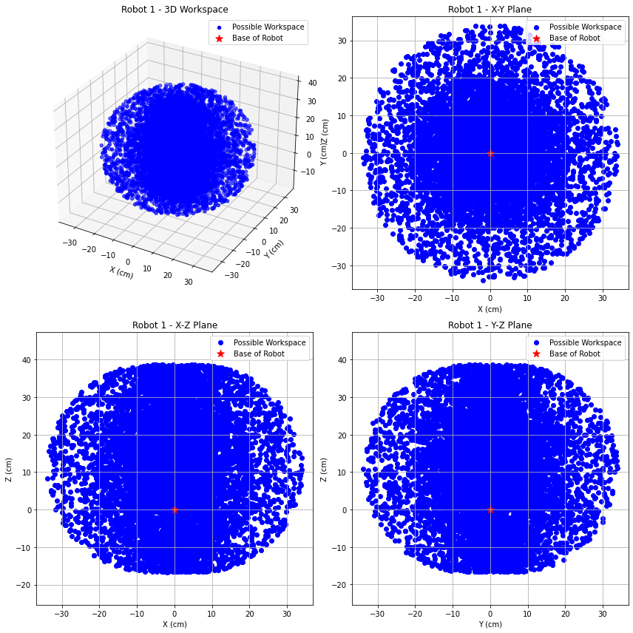
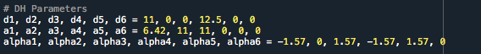
Solution Space Calculations
Solution Space Calculations:
Performed using Monte Carlo random sampling of joint angles within the range (-π, π).
Forward Kinematics
Robot 1:
Dimensioning based off of our sizing for human arm
Does Not meet the 2 feet radius workspace desired by LANL
Adjustments need to be made to dimensioning

Slide 9
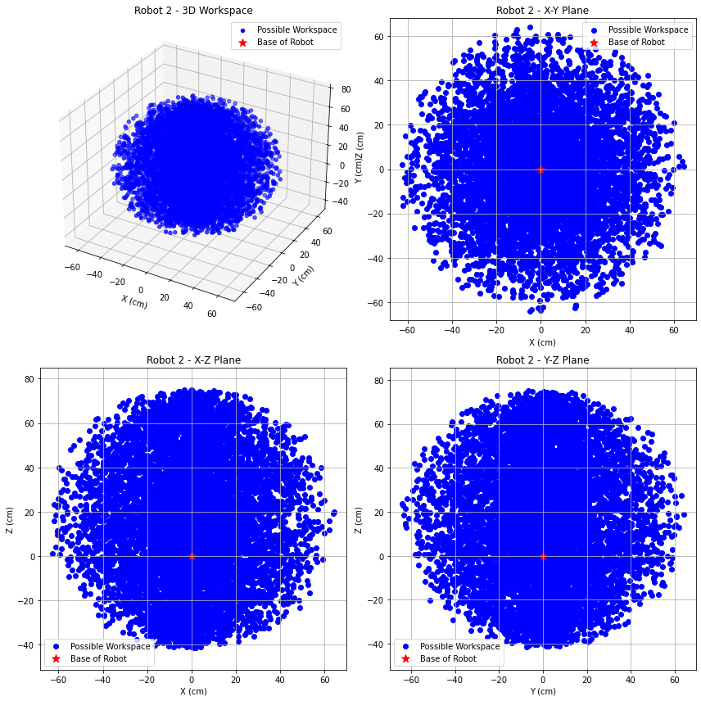
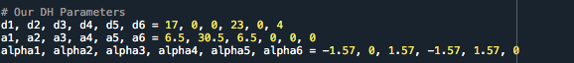
Solution Space Calculations
Robot 2:
Dimensioned based on human arm proportions, with adjustments.
Achieves the 2-foot radius workspace required by LANL.
Scheduled for presentation to David on Friday for validation.
All values are easily adjustable and can be modified as needed.

Slide 10
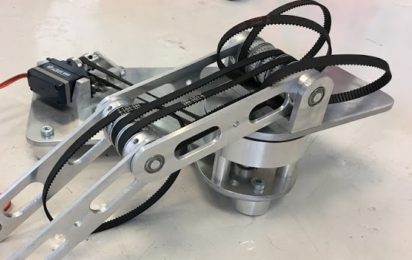
Future Work
Considerations
Translational Joints:
Exploring pulley cable mechanisms.
Rotational Joints:
Evaluating motor options for effective movement.
Design Selection
Preliminary design has been established.
Focus on selecting mechanical components for six joints.
Joint Configuration
Three rotary joints
Three translational joints
Torque and Speed Calculations
Determine desirable torque for each joint.
Calculate required rotational speed for optimal performance.

Slide 11
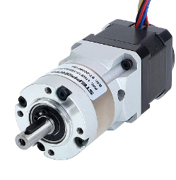
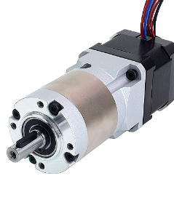
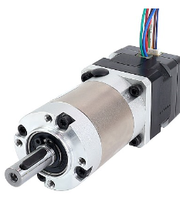
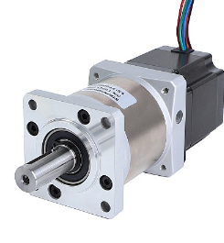
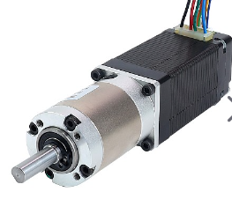
Motor Evaluation Joints 1-6
Torque Requirements
Speed (RPM)
Motor Type
Stepper Motors
Servo Motors
Brushless DC Motor
Size/Weight
Power Supply Voltage
Cost
Integration w/ Electronics
Feedback Mechanism
Drivers…

Slide 12
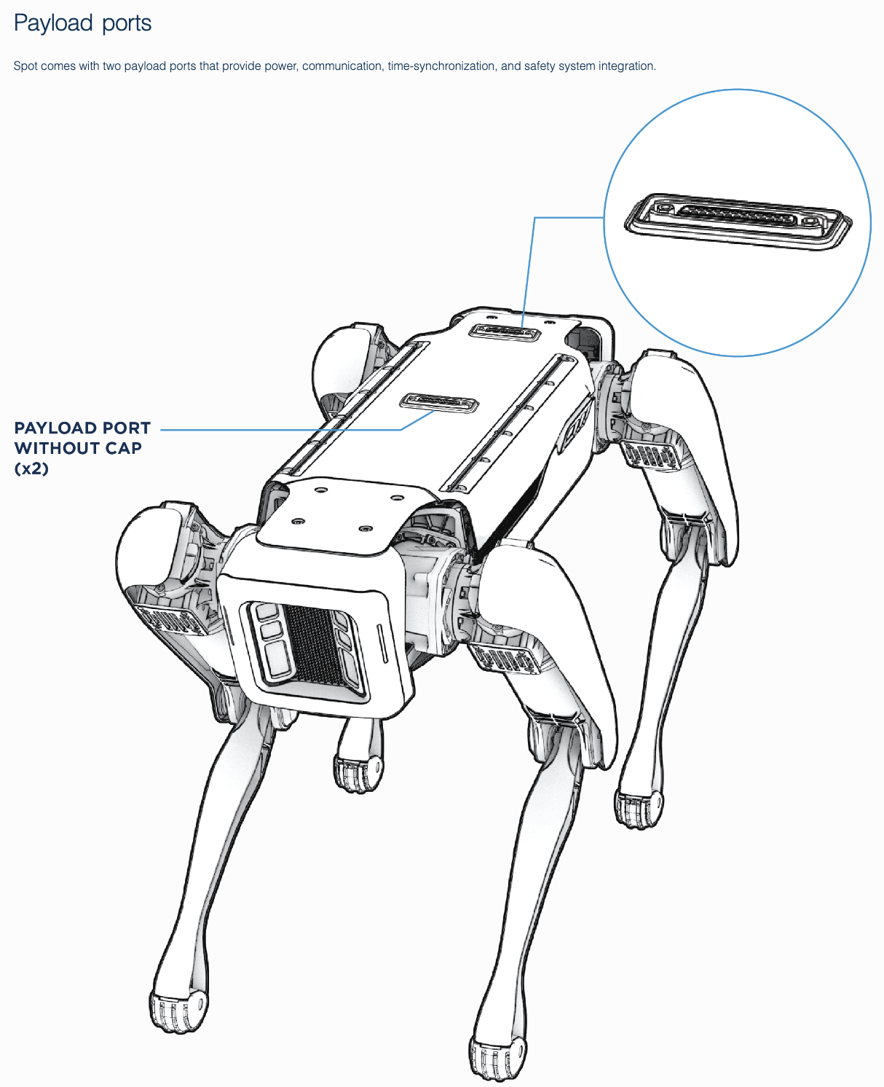
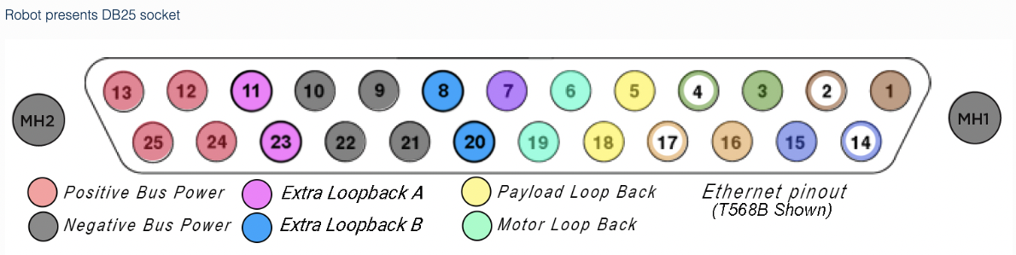
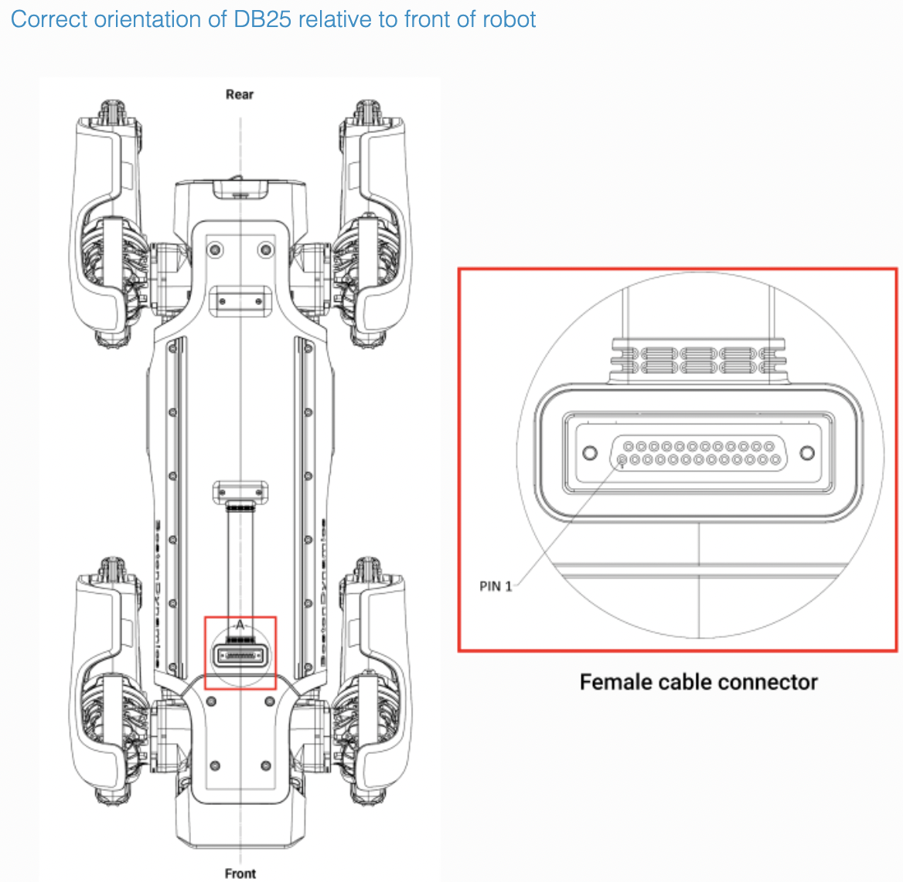
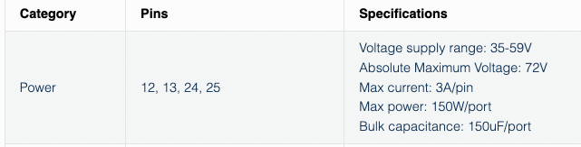
Electrical Components
Electrical Interface Female Payload Ports

Slide 13
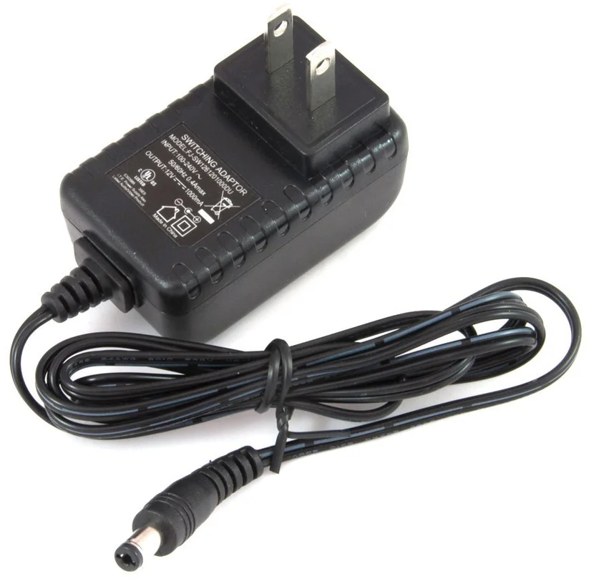
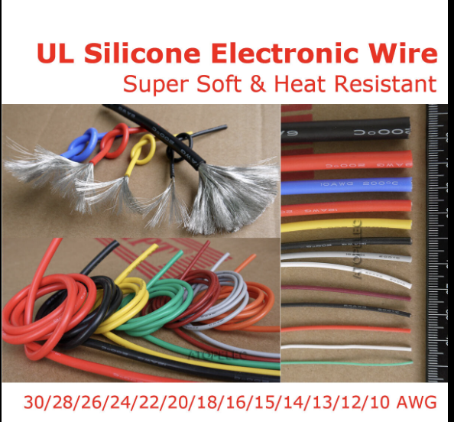
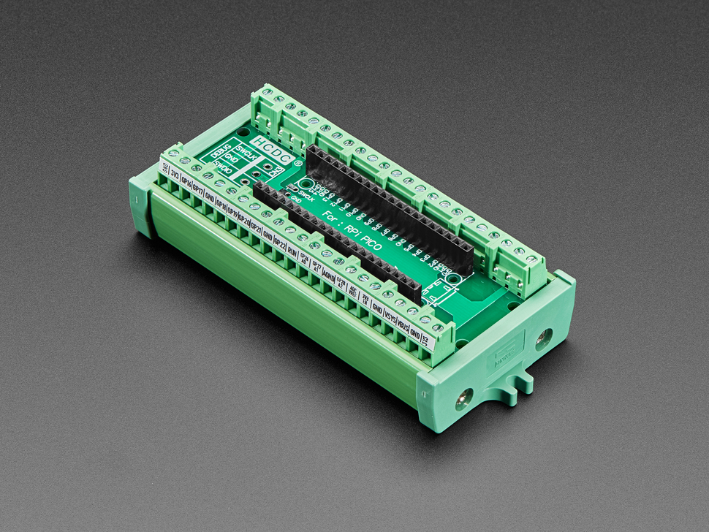
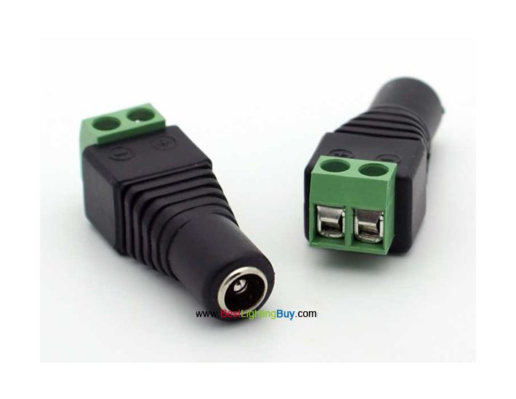
Electrical Components
Steps to determine power needed for robotic arm:
Identify required voltage
Calculate the total current draw in amps by summing up the power requirements of each component
Choose a DC power supply to convert the wall voltage to a usable voltage
Connect robotic power lines using a DC barrel jack socket
Terminal Block Breakout Module

Slide 14

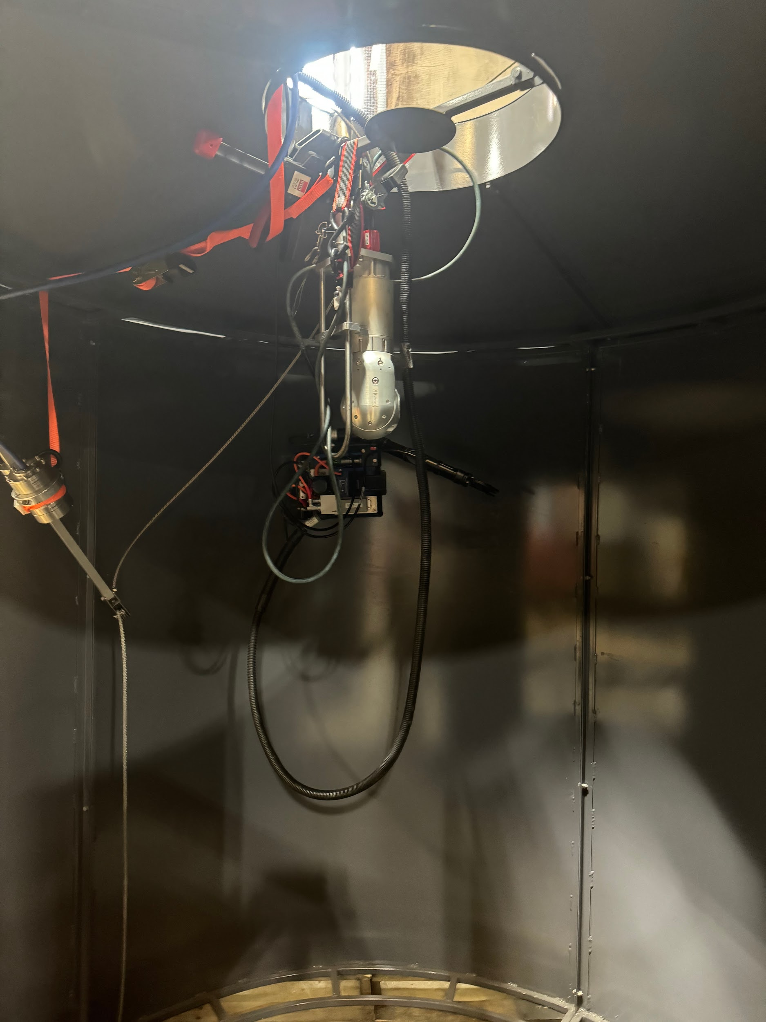
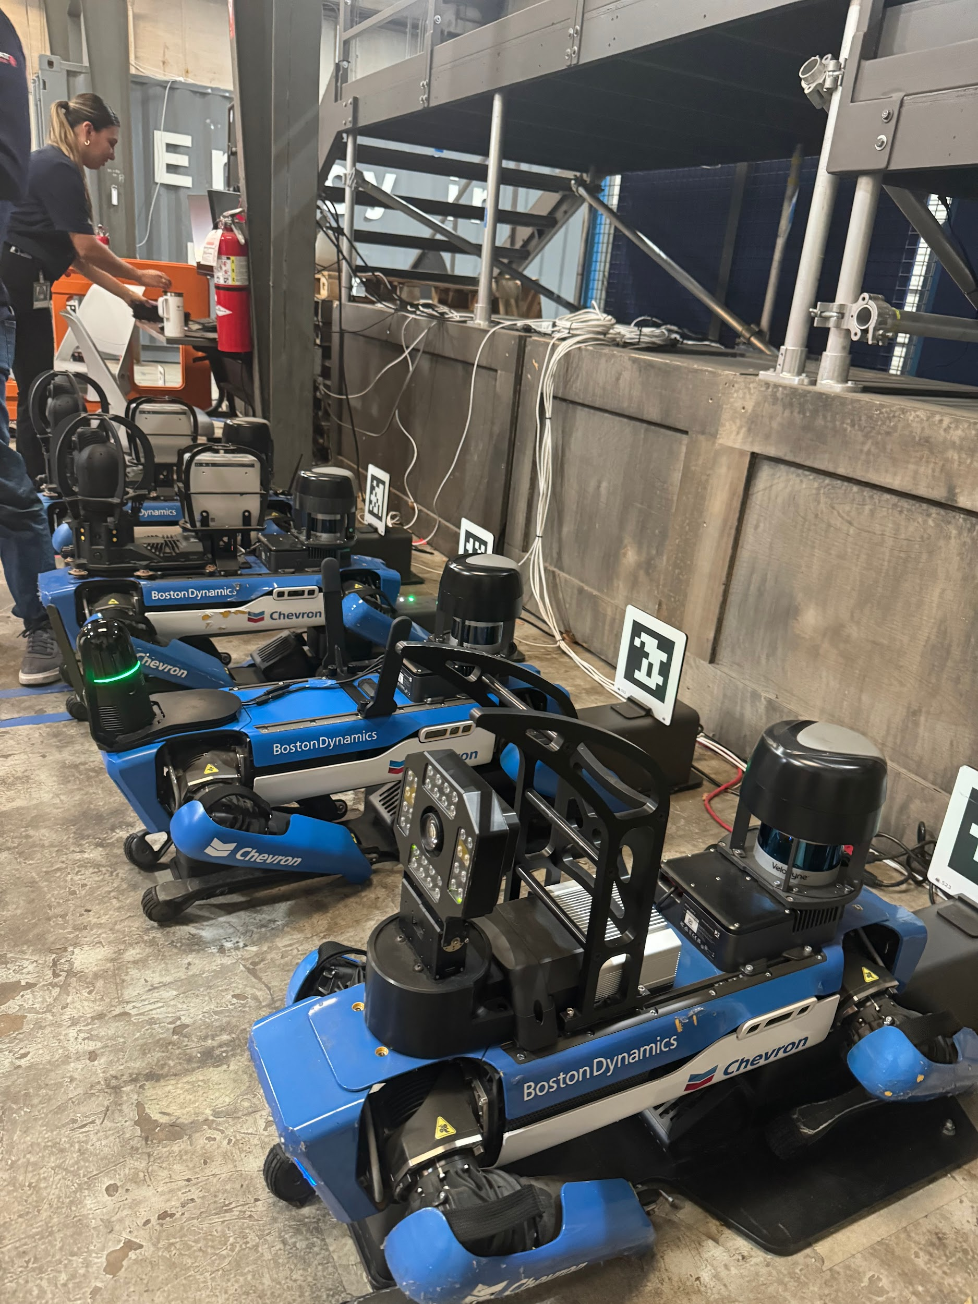
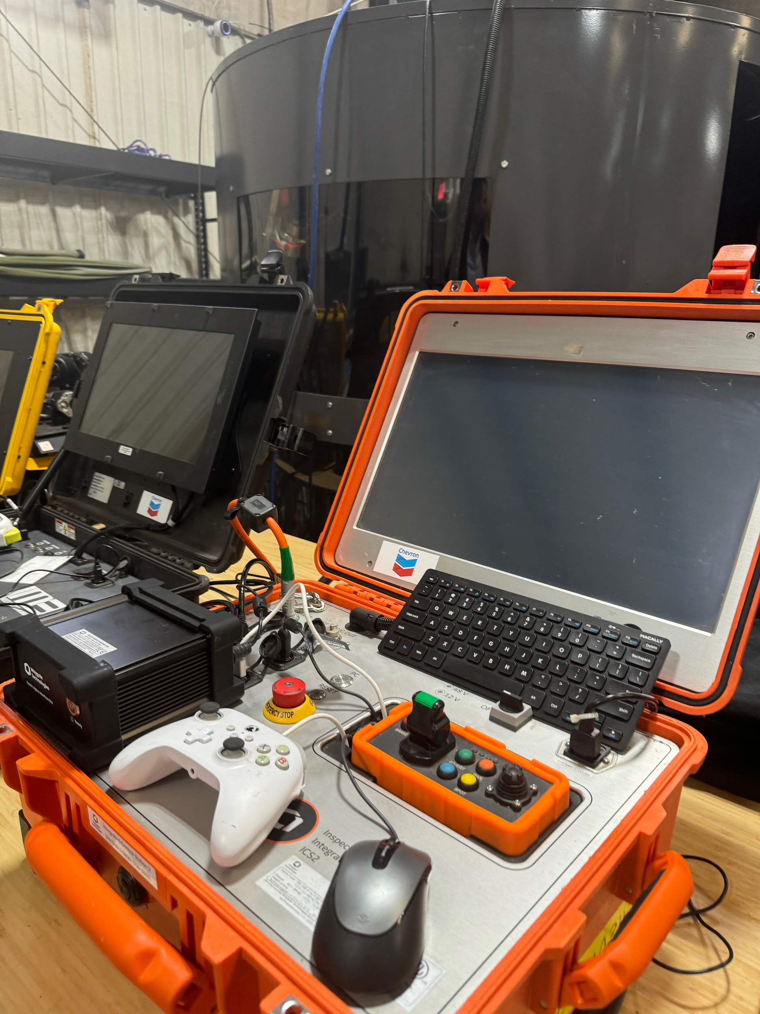
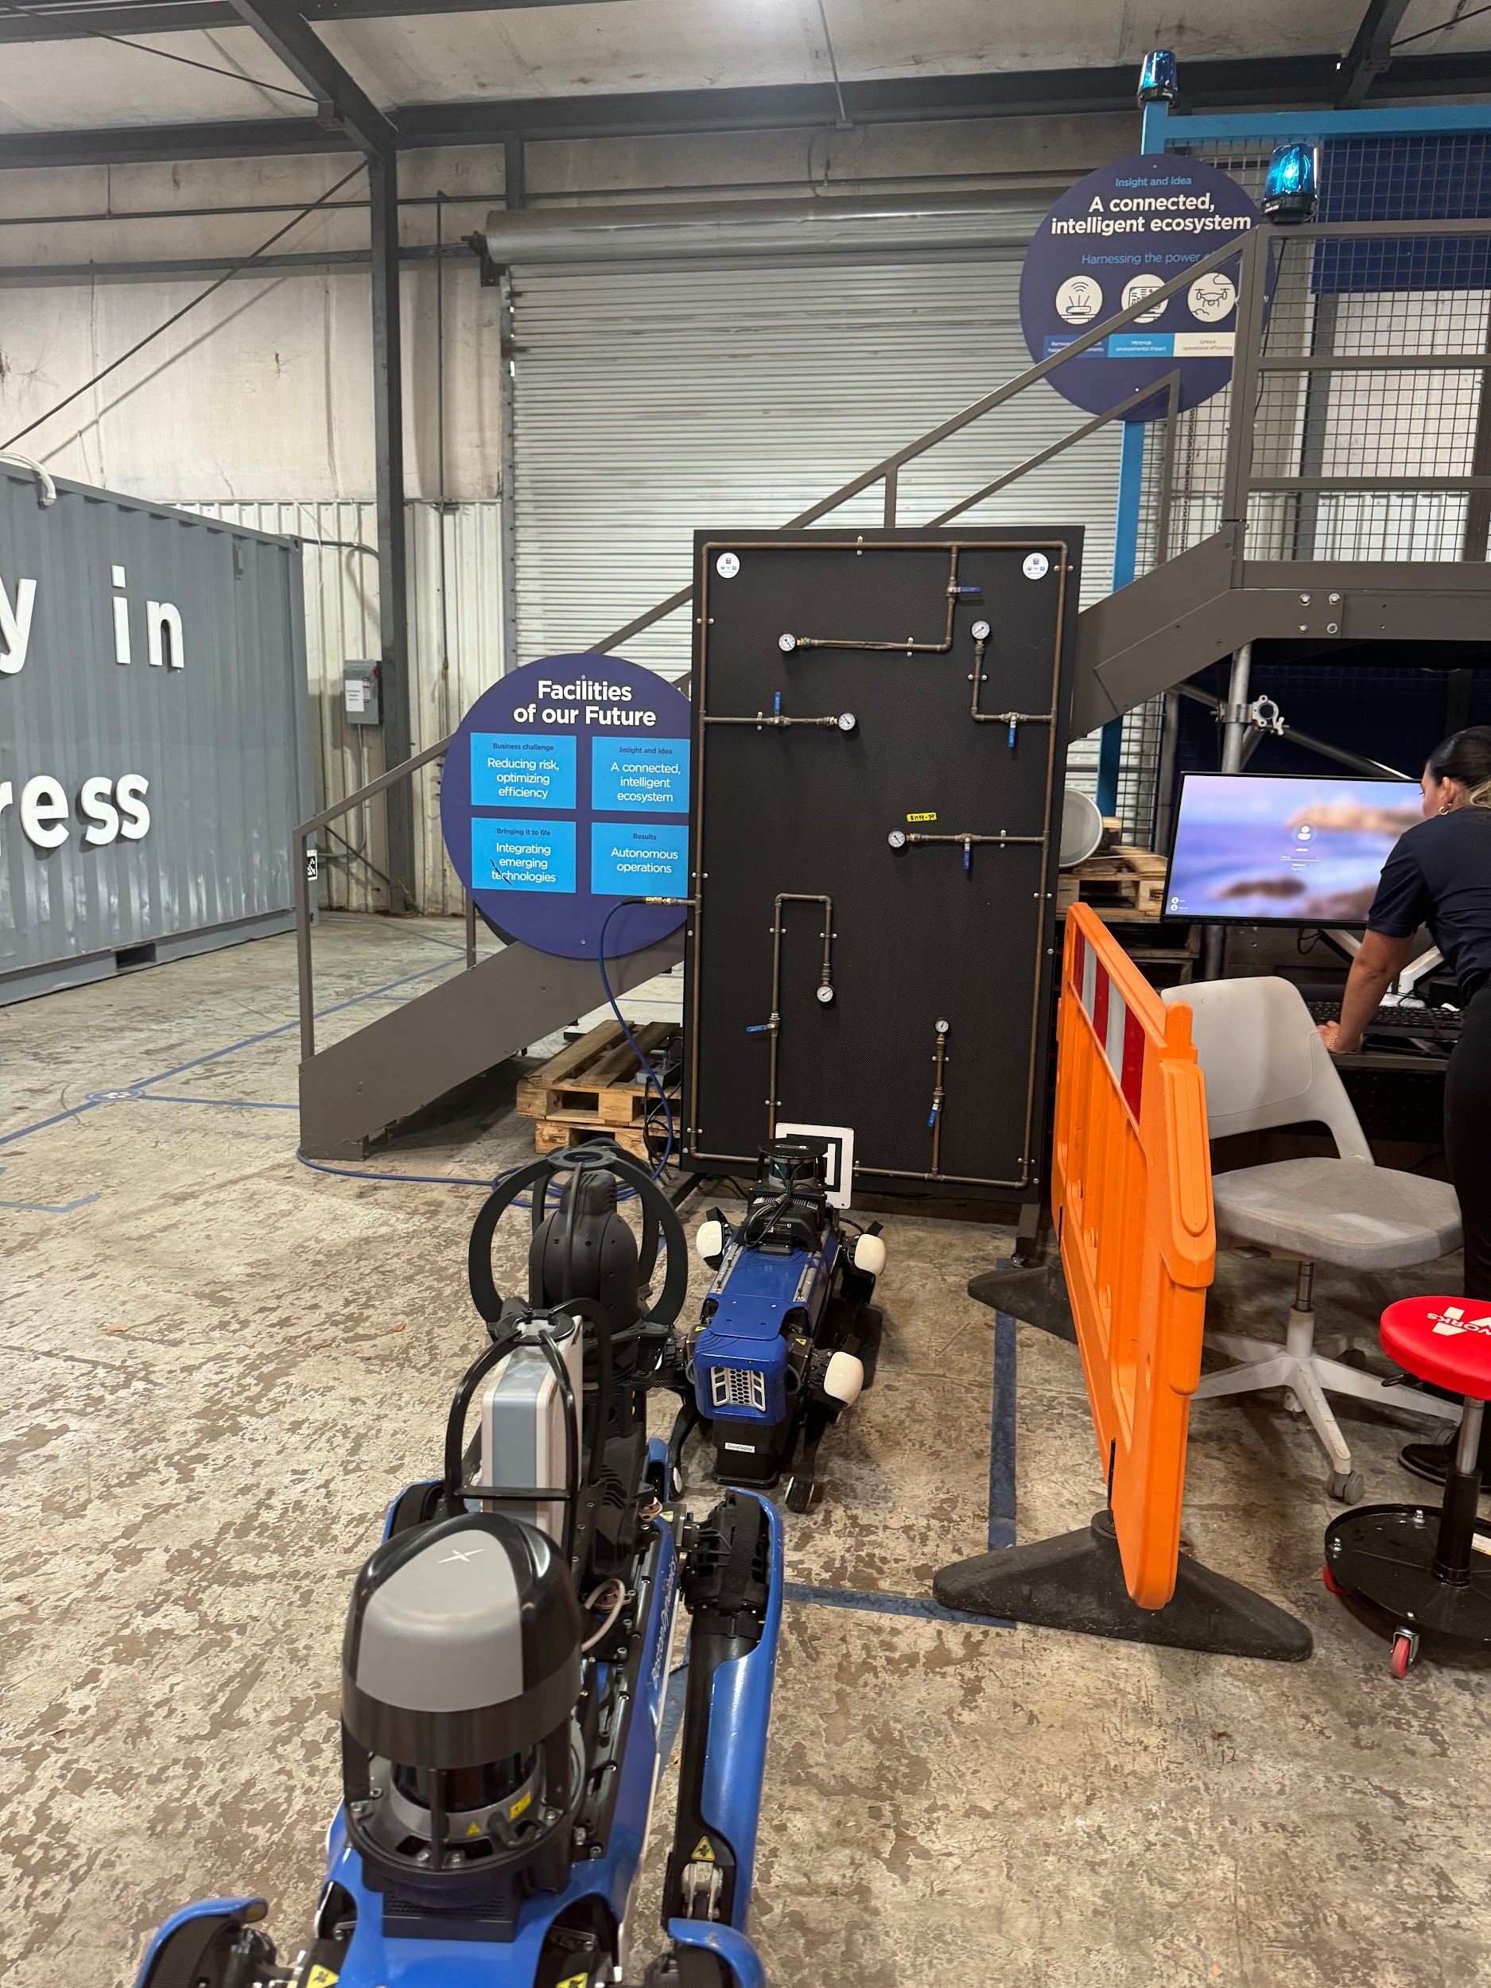
Site Visits
Tour on 10/8 - Met with Betsy Perales (Robotics Operations Engineer)

Slide 15

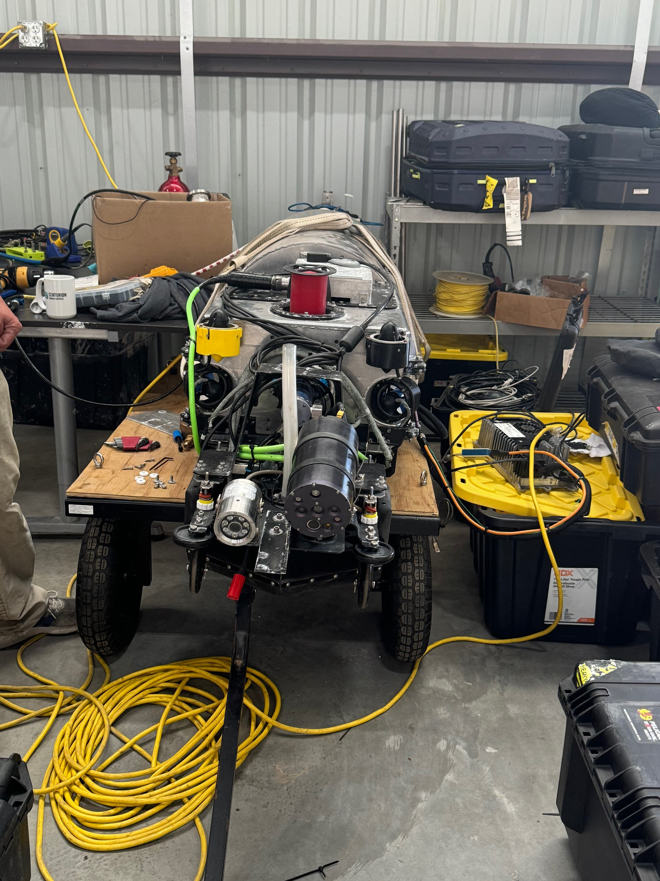
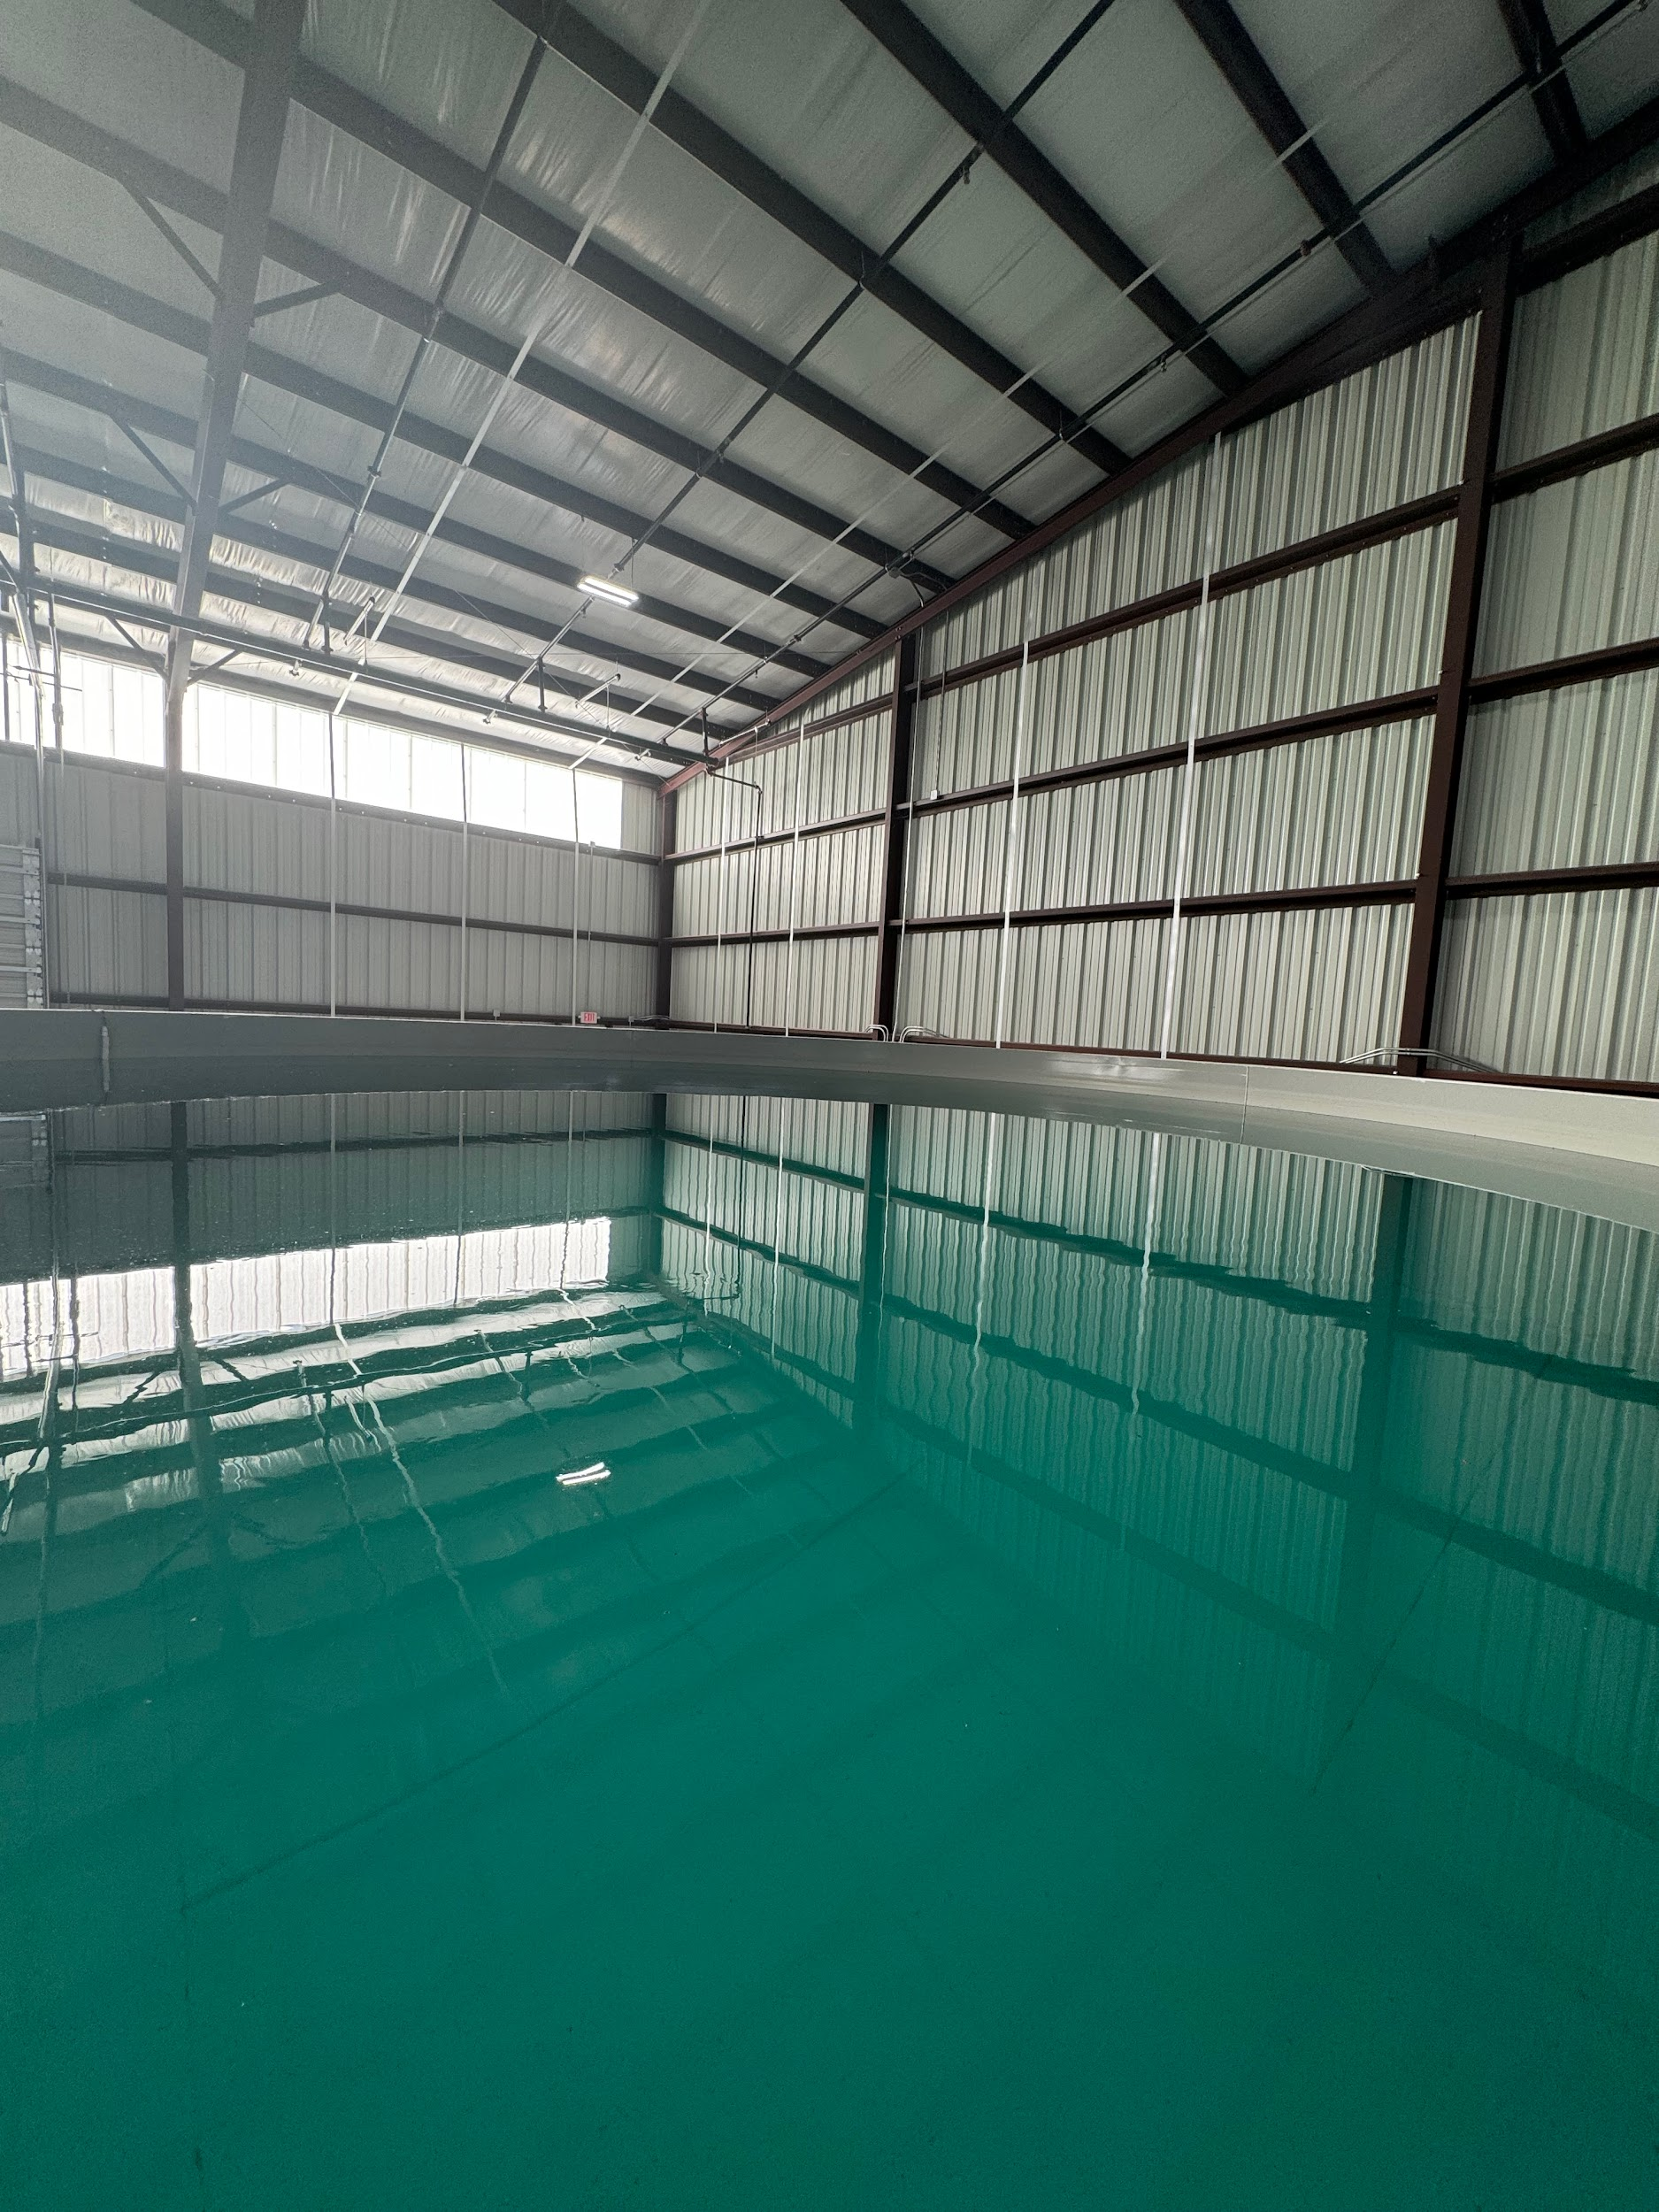
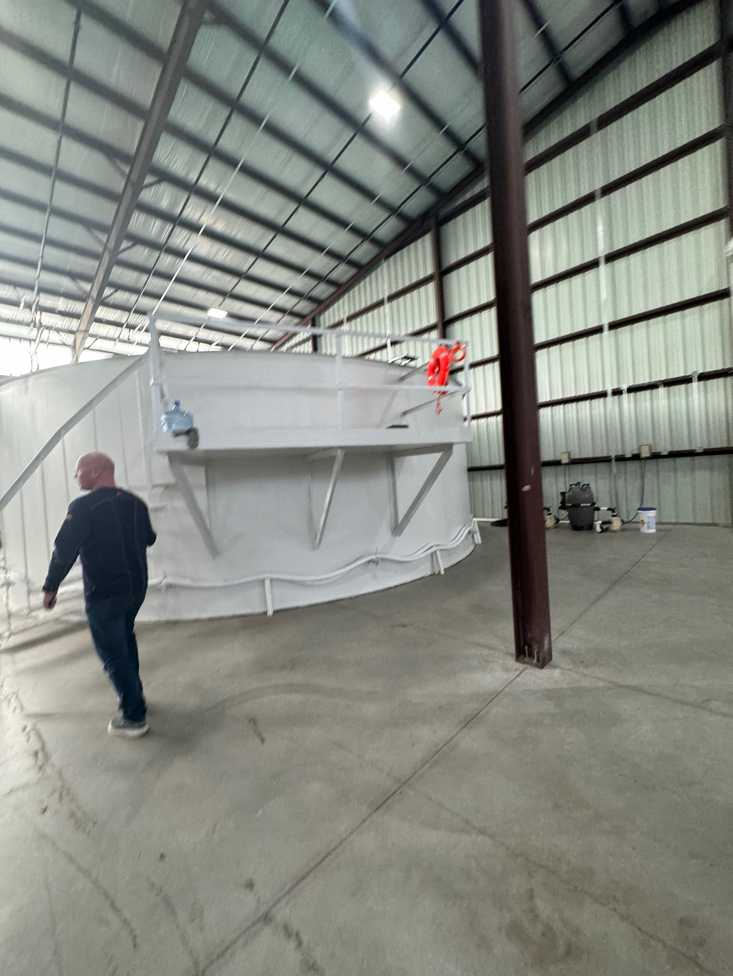



Site Visits
Met with Damien Goodyear - Director of Operations (10/8)
Customers

Slide 16
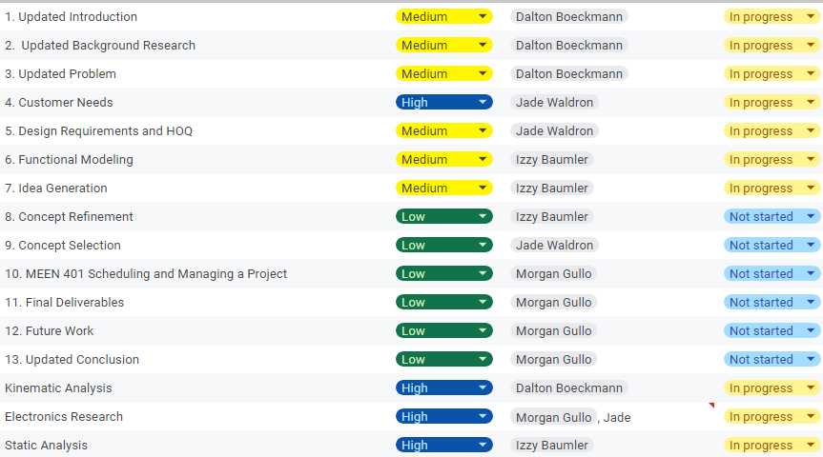
Schedule

Slide 17
Upcoming Week
Meeting with David Friday at 10 AM
Meeting with Rodrigo and Michael for customer needs questionnaire on Thursday at 11 AM
Continue working on DR2 report
Finalize Motor Selection/Joint Calculations
Supplemental Design Survey

